Slide 1
IBM® Managing Sterling File Gateway V2.6.6.1
Course code: 6F86G
ERC1.1
© Copyright IBM Corporation 2015
Notes:
© Copyright IBM Corporation 2015

Slide 2
Course overview
This 2 days course is designed for end users, programmers, and administrators to explain the installation, configuration, routing file transfers, and application extensibility.
The course provides hands-on exercises along with the informational content.
The course provides the VMware image as an environment to perform hands-on exercises.
The course provides printable/soft copies of the content will be delivered to the registered participants.
© Copyright IBM Corporation 2015
Notes:
© Copyright IBM Corporation 2015

Slide 3
Prerequisites
The prerequisites for taking this course are:
Participants should have a working knowledge of IBM® Sterling B2B Integrator.
Awareness of File Transfer Protocols.
© Copyright IBM Corporation 2015
Notes:
© Copyright IBM Corporation 2015

Slide 4
Course objectives
Install and configure Sterling File Gateway.
Describe community, groups and users.
Build static and dynamic routing channel templates.
Describe the different persona’s and their responsibilities.
Configure routing channels.
Transfer file from a producer to a consumer.
Broadcast messages.
Explain the enhanced visibility to track a route.
Explain container and non-container layers.
Configuration to generate reports.
Discuss the procedure for Sterling File Gateway extensibility.
© Copyright IBM Corporation 2015
Notes:
© Copyright IBM Corporation 2015

Slide 5
Audience
The intended audience for this course are
  System administrators
  Operators
  Implementers
  Product support team and
  Testers
who are responsible for analyzing client requirements, and provide support for the Sterling File Gateway.
© Copyright IBM Corporation 2015
Notes:
© Copyright IBM Corporation 2015

Slide 6
Course Agenda
This course is organized into two units:
Unit 1: Overview of Sterling File Gateway
    Lesson 1: Introduction
    Lesson 2: Users and Trading Partners
    Lesson 3: Routing Channel Templates
    Lesson 4: Mailbox Management
    Lesson 5: Static Routes
Unit 2: Implementation
    Lesson 1: Dynamic Routes
    Lesson 2: File Layers
    Lesson 3: Extensibility
    Lesson 4: Reports
© Copyright IBM Corporation 2015
Notes:
© Copyright IBM Corporation 2015

Slide 7
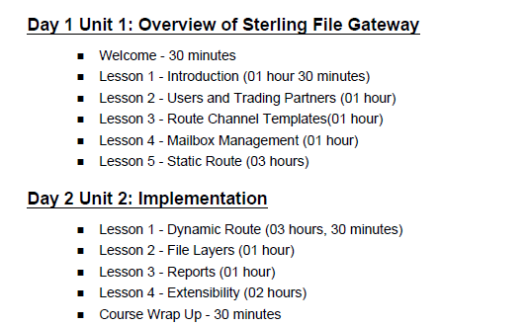
Schedule
© Copyright IBM Corporation 2015
Notes:
© Copyright IBM Corporation 2015

Slide 8

Questions
© Copyright IBM Corporation 2015
Notes:
© Copyright IBM Corporation 2015

